Slide 1
Twitter – Why and how
Gustav Sternelöv

Slide 2
What is Twitter?
Social network, launched in 2006
Tweets, maximum 140 characters
1.3 billion registered users
320 million monthly active users
On average 303 million tweets/day (January 2016)

Slide 3
Access Twitter data
Two public API:s
Twitter REST API
Streaming API
R packages for easy access (twitteR, streamR)

Slide 4
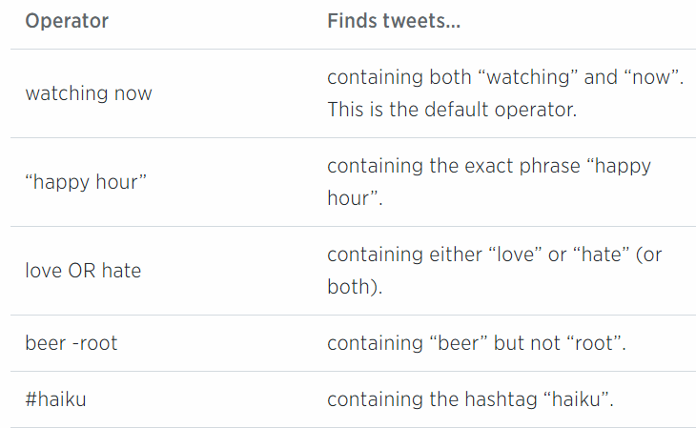
Access Twitter data
Twitter REST API
Querys from search API
Follower data, profile data, tweets
Limitation of requests
Twitter Search API
Searches against a sample of recent tweets
Tweets published in the past 7 days

Slide 5
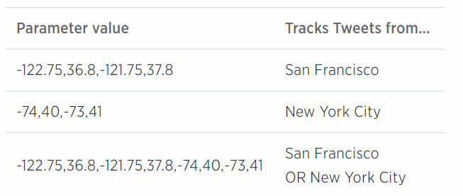
Access Twitter data
Streaming API
Location queries
Tweets as they are tweeted
No sampling
Public stream and user stream
Recieve tweets depending on language, user/users, words/hashtags or location

Slide 6
The use of tweets
Predict real world outcomes
Presidential elections
Box-office revenues for movies
Detect earthquakes
What people write about diseases – Public health information

Slide 7
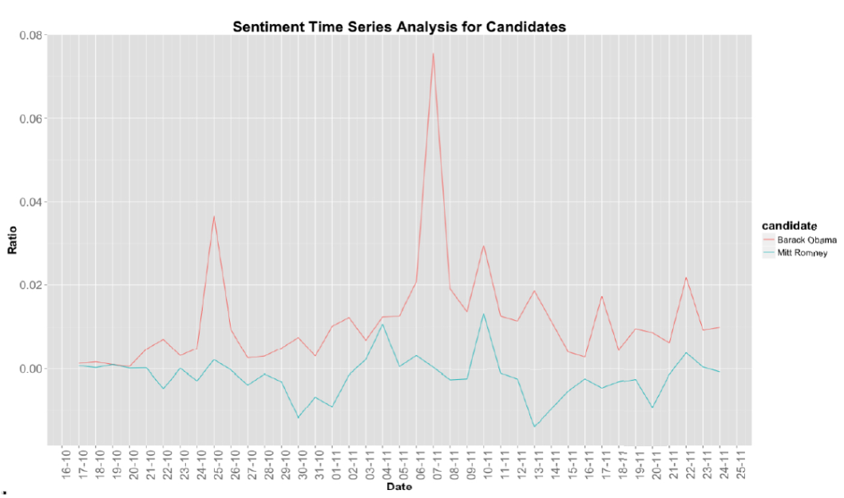
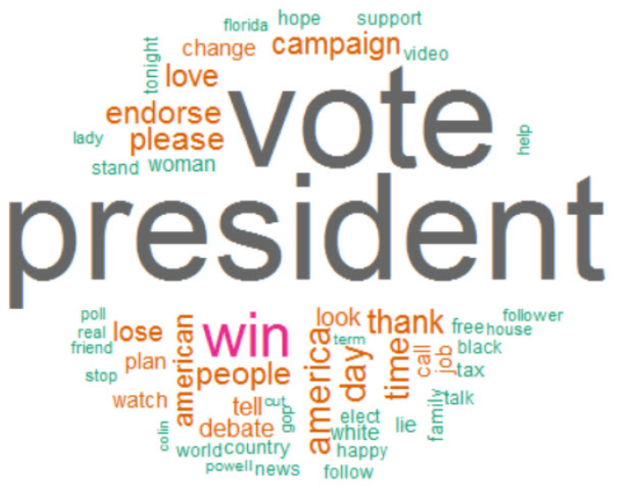
US presidential elections in tweets
Sentiment analysis
Classify tweets as negative, positive or neutral
Public opinion on the main candidates during the weeks before the election
Word clouds
What people tweets together with ”election”

Slide 9
Data pre-processing
Clean data
All letters in lowercase
Remove punctutations, smileys etc.
Steeming
TF-IDF transformations
Something more?

Slide 10
Analyze tweets
Sentiment analysis
Estimate public opinion
Proportion of tweets that are positive/negative
Word clouds
Classification
K-means
K-nearest-neighbors
Naive Bayes
Support vector machine
Random forest

Slide 11
Sentiment analysis
Classification of tweets
Is a word positive or negative?
How positive or negative is it?
Disadvantage: Hard to classify words, depends on the choice of one or a small group of individuals

